Slide 1
Operating System
Tim Pengampu MK Sistem Operasi
Universitas Dian Nuswantoro

Slide 2
Process
An operating system executes a variety of programs that run as a process.
Process – a program / command / else in being execution / being execute; process execution must progress in sequential fashion
Multiple parts
The program code, also called text section
Current activity including program counter, processor registers
Stack containing temporary data
Function parameters, return addresses, local variables
Data section containing global variables
Heap containing memory dynamically allocated during run time
Program is passive entity stored on disk (executable file); process is active
Program becomes process when executable file loaded into memory
Execution of program started via GUI mouse clicks, command line entry of its name, etc
One program can be several processes
Consider multiple users executing the same program

Slide 3
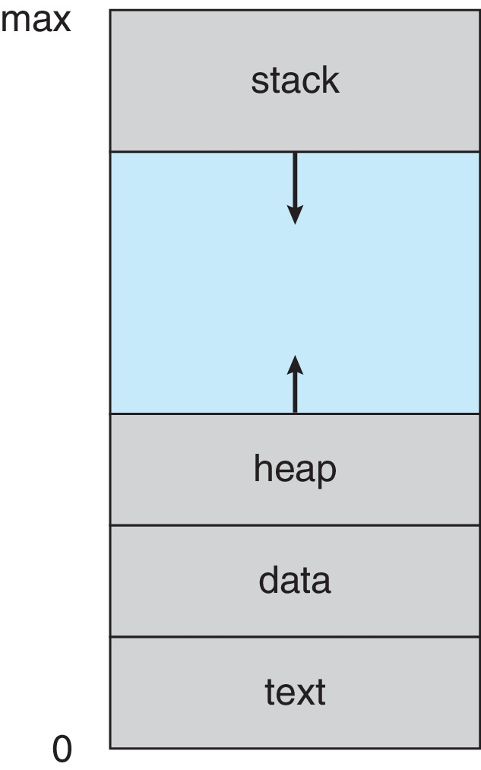
Process in Memory

Slide 4
Process State
As a process executes, it changes state
New: The process is being created
Running: Instructions are being executed
Waiting: The process is waiting for some event to occur
Ready: The process is waiting to be assigned to a processor
Terminated: The process has finished execution

Slide 5
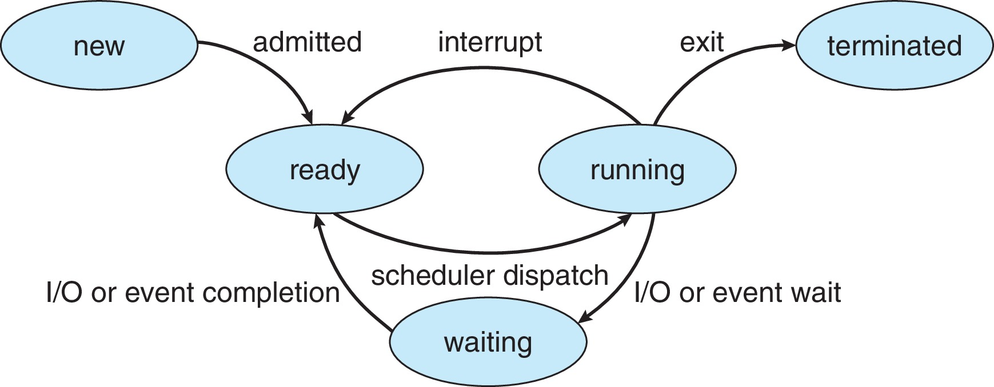
Diagram of Process State

Slide 6
Process State Transition Diagram with Two Suspend States
New
Admit
Suspend
Admit
Activate
Dispatch
Ready,
suspend
Ready
Running
Exit
Suspend
Time out
Event
Occurs
Event
Wait
Event
Occurs
Activate
Blocked,
suspend
Blocked
Suspend

Slide 7
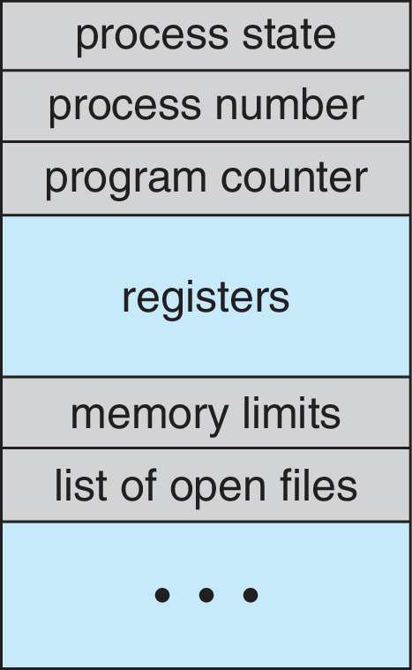
Process Control Block (PCB)
Information associated with each process
(also called task control block)
Process state – running, waiting, etc
Program counter – location of instruction to next execute
CPU registers – contents of all process-centric registers
CPU scheduling information- priorities, scheduling queue pointers
Memory-management information – memory allocated to the process
Accounting information – CPU used, clock time elapsed since start, time limits
I/O status information – I/O devices allocated to process, list of open files

Slide 8
Threads
So far, process has a single thread of execution
Consider having multiple program counters per process
Multiple locations can execute at once
Multiple threads of control -> threads
Must then have storage for thread details, multiple program counters in PCB

Slide 9
Single and multithreaded processes
process control block
code
data
files
process control block
code
data
files
registers
user/kernel stacks
registers
registers
registers
Thread control blocks
user /kernel stacks
user /kernel stacks
user /kernel stacks
thread
thread
thread
thread
single threaded
multithreaded

Slide 10
Process Scheduling
Maximize CPU use, quickly switch processes onto CPU core
Process scheduler selects among available processes for next execution on CPU core
Maintains scheduling queues of processes
Ready queue – set of all processes residing in main memory, ready and waiting to execute
Wait queues – set of processes waiting for an event (i.e. I/O)
Processes migrate among the various queues

Slide 11
Context Switch
When CPU switches to another process, the system must save the state of the old process and load the saved state for the new process via a context switch
Context of a process represented in the PCB
Context-switch time is overhead; the system does no useful work while switching
The more complex the OS and the PCB ➔ the longer the context switch
Time dependent on hardware support
Some hardware provides multiple sets of registers per CPU ➔ multiple contexts loaded at once

Slide 12
Multitasking in Mobile Systems
Some mobile systems (e.g., early version of iOS) allow only one process to run, others suspended
Due to screen real estate, user interface limits iOS provides for a
Single foreground process- controlled via user interface
Multiple background processes– in memory, running, but not on the display, and with limits
Limits include single, short task, receiving notification of events, specific long-running tasks like audio playback
Android runs foreground and background, with fewer limits
Background process uses a service to perform tasks
Service can keep running even if background process is suspended
Service has no user interface, small memory use

Slide 13
Operations on Processes
System must provide mechanisms for:
process creation
process termination

Slide 14
Process Creation
When is a new process created?
System initialization (Daemons)
Execution of a process creation system call by a running process
A user request to create a process
Initiation of a batch job

Slide 15
Process Creation
Parent process create children processes, which, in turn create other processes, forming a tree of processes
Generally, process identified and managed via a process identifier (pid)
Resource sharing options
Parent and children share all resources
Children share subset of parent’s resources
Parent and child share no resources
Execution options
Parent and children execute concurrently
Parent waits until children terminate

Slide 16
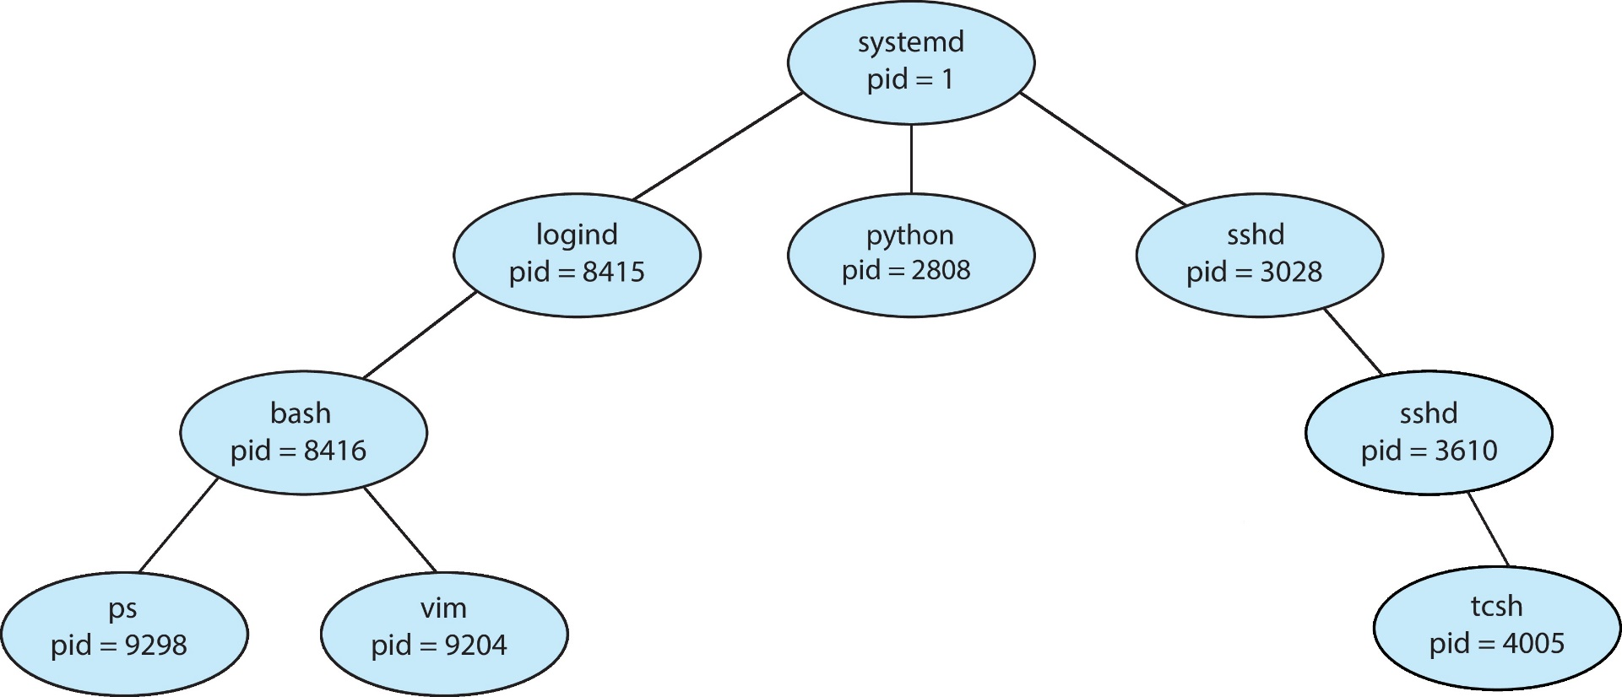
A Tree of Processes in Linux

Slide 17
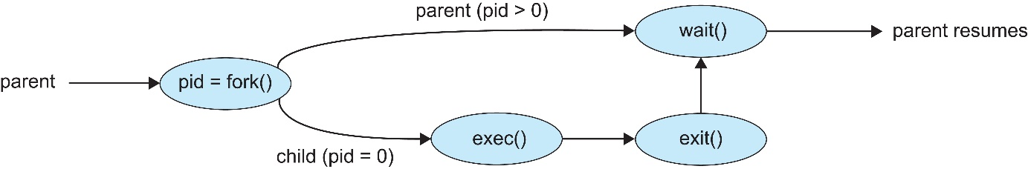
Process Creation (Cont.)
Address space
Child duplicate of parent
Child has a program loaded into it
UNIX examples
fork() system call creates new process
exec() system call used after a fork() to replace the process’ memory space with a new program
Parent process calls wait() for the child to terminate

Slide 18
Process Termination
When does a process terminate?
Normal exit (voluntary)
Error exit (voluntary)
Fatal error (involuntary)
Killed by another process (involuntary)

Slide 19
Process Termination
Process executes last statement and then asks the operating system to delete it using the exit() system call.
Returns status data from child to parent (via wait())
Process’ resources are deallocated by operating system
Parent may terminate the execution of children processes using the abort() system call. Some reasons for doing so:
Child has exceeded allocated resources
Task assigned to child is no longer required
The parent is exiting and the operating systems does not allow a child to continue if its parent terminates

Slide 20
Process Termination (Cont.)
Some operating systems do not allow child to exists if its parent has terminated. If a process terminates, then all its children must also be terminated.
cascading termination. All children, grandchildren, etc. are terminated.
The termination is initiated by the operating system.
The parent process may wait for termination of a child process by using the wait()system call. The call returns status information and the pid of the terminated process
pid = wait(&status);
If no parent waiting (did not invoke wait()) process is a zombie
If parent terminated without invoking wait , process is an orphan

Slide 21
Android Process Importance Hierarchy
Mobile operating systems often have to terminate processes to reclaim system resources such as memory. From most to least important:
Foreground process
Visible process
Service process
Background process
Empty process
Android will begin terminating processes that are least important.

Slide 22

Multiprocess Architecture – Chrome Browser
Many web browsers ran as single process (some still do)
If one web site causes trouble, entire browser can hang or crash
Google Chrome Browser is multiprocess with 3 different types of processes:
Browser process manages user interface, disk and network I/O
Renderer process renders web pages, deals with HTML, Javascript. A new renderer created for each website opened
Runs in sandbox restricting disk and network I/O, minimizing effect of security exploits
Plug-in process for each type of plug-in

Slide 23
Other(s) Term on Process
Concurrency
Mutual Exclusion
Starvation
Deadlock

Slide 24
Deadlock
Permanent blocking of a set of processes that either compete for system resources or communicate with each other
Involves conflicting needs for resources by two or more processes
There is no satisfactory solution in the general case
Some OS (ex: Unix SVR4) ignore the problem and pretend that deadlocks never occur...

Slide 25
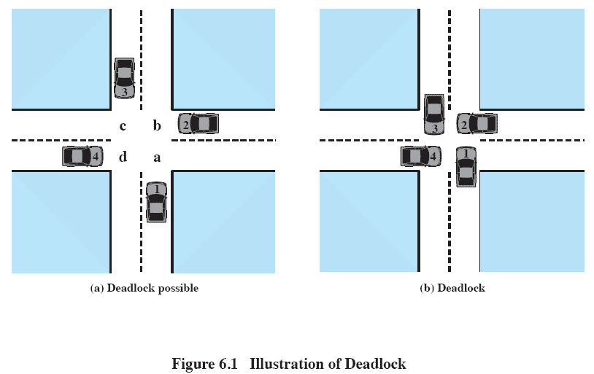
Deadlock

Slide 26
The Conditions for Deadlock
These 3 conditions of policy must be present for a deadlock to be possible:
1: Mutual exclusion
only one process may use a resource at a time
2: Hold-and-wait
a process may hold allocated resources while awaiting assignment of others
3: No preemption
no resource can be forcibly removed from a process holding it

Slide 27
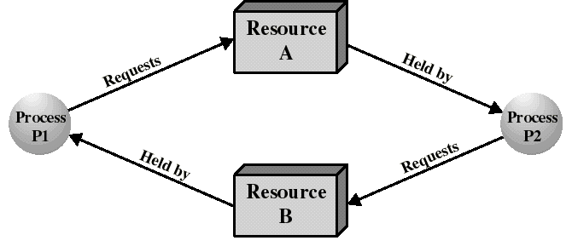
The Conditions for Deadlock
We also need the occurrence of a particular sequence of events that result in:
4: Circular wait
a closed chain of processes exists, such that each process holds at least one resource needed by the next process in the chain

Slide 28
The Conditions for Deadlock
Deadlock occurs if and only if the circular wait condition is unresolvable
The circular wait condition is unresolvable when the first 3 policy conditions hold
Thus the 4 conditions taken together constitute necessary and sufficient conditions for deadlock

Slide 29
Deadlock Prevention
Mutual Exclusion
Must be supported by the OS
Hold and Wait
Require a process request all of its required resources at one time

Slide 30
Deadlock Prevention
No Preemption
Process must release resource and request again
OS may preempt a process to require it releases its resources
Circular Wait
Define a linear ordering of resource types

Slide 31
Deadlock Avoidance
A decision is made dynamically whether the current resource allocation request will, if granted, potentially lead to a deadlock
Requires knowledge of future process requests

Slide 32
Two Approaches to Deadlock Avoidance
Do not start a process if its demands might lead to deadlock
Do not grant an incremental resource request to a process if this allocation might lead to deadlock

Slide 33
Resource Allocation Denial
Referred to as the banker’s algorithm
State of the system is the current allocation of resources to process
Safe state is where there is at least one sequence that does not result in deadlock
Unsafe state is a state that is not safe

Slide 34
Example
Process | Resource Allocated | Resource Needed
A | 2 | 10
B | 1 | 3
C | 3 | 7
Resource Available : 4
Is it on safe state or unsafe state ?

Slide 35

Any Question ?
Anything to discuss ?

